Slide 1
Capstone Project :Netflix Data
Presented by Seb Creighton

Slide 2
List of visualisations and my role
Here are visualisations to be covered:
Distributions of Stock Prices for Netflix in 2017
Netflix stock and revenue for the past 4 quarters
Earned versus actual earnings per share
Netflix stock against the Dow Jones stock
My role is to aid financial analysts by creating some of the visualisations for a stock profile of Netflix.

Slide 3
Distributions of Stock Prices for Netflix in 2017
tock price increases over quarter
Greater distribution came in Q3
Q4 has greater median of Netflix stock price whilst Q1 has lowest due to positioning of white dot
Most of prices fall through 135-150 range
Lowest was around 122 whilst highest was around 205

Slide 4
Netflix stock and revenue for the past 4 quarters
Purple dots indicate actual and estimate value are the exact same.
Q2 and Q4 matches the above.

Slide 5
Earned versus actual earnings per share
As quarter changes, revenue increases by 6%, 10% and then 12.5%.
As quarter changes, earnings increases by 91.9%, 143% and 156%.
Earnings constitutes roughly 5% of revenue.
Revenue is increasing faster than earnings their costs are increasing (earnings = revenue - cost)

Slide 6
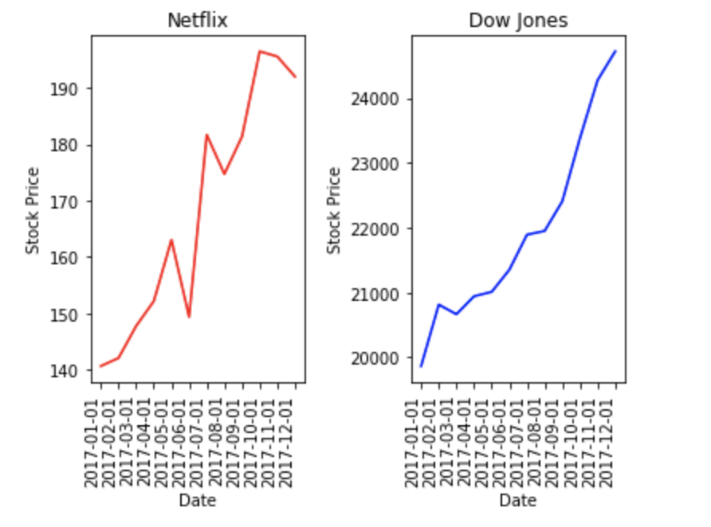
Netflix stock against the Dow Jones stock in 2017
Netflix performed much worse than Dow Jones even though stock prices increased for both.
Netflix is more volatile as more peak-y.

